Slide 1
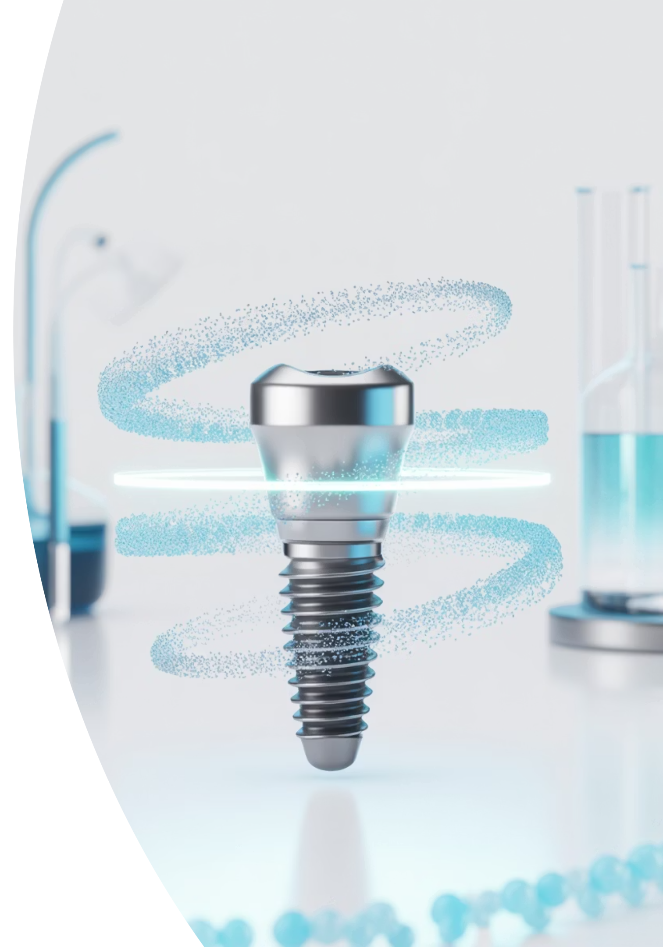
HUMED LIFESCIENCES
"Transforming patient access to Dental Implant treatments to those that need it the most"
JULY 2025

Slide 2
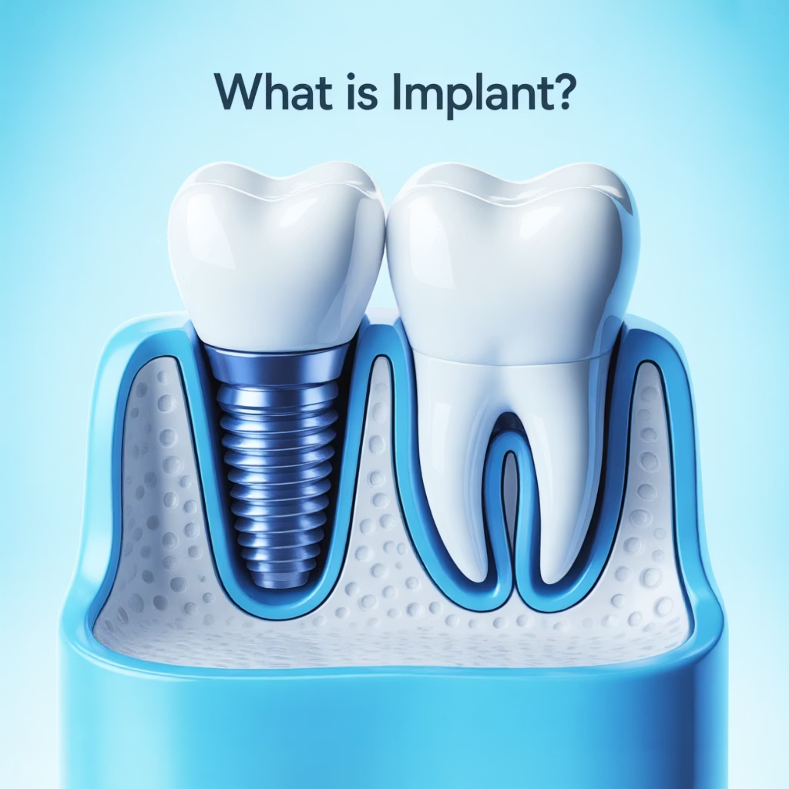
Fundamental Implant Breakthrough in 30+ Years
Dental implants: Artificial tooth roots replacing missing teeth
1980s: Osseointegration breakthrough enabled titanium fusion
Three decades of only minor surface modifications since then
HuMed delivers long-awaited structural advancement
Receive Treatment
No Treatment

Slide 3
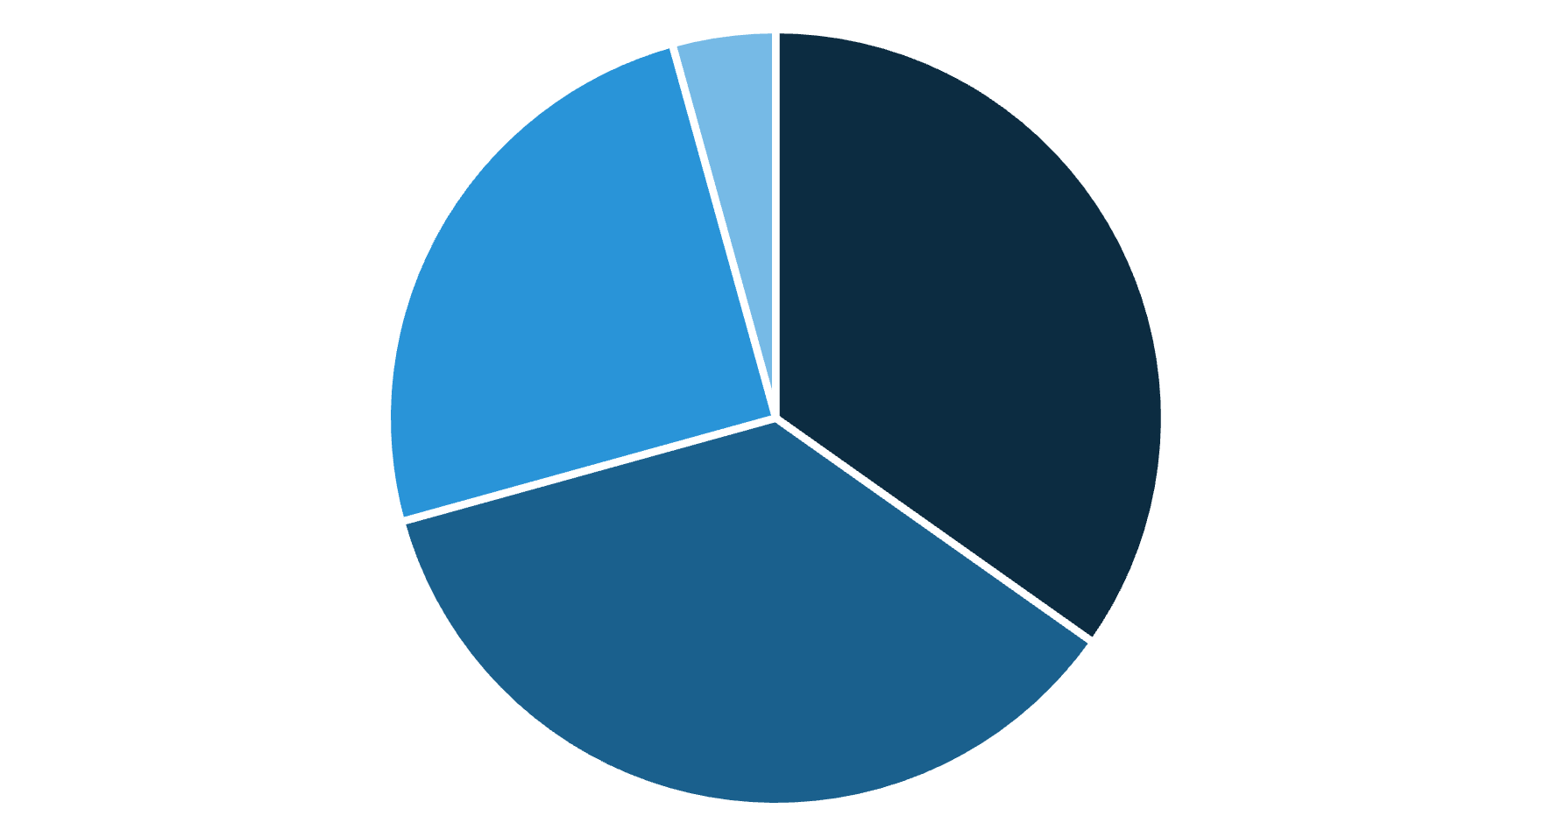
Thriving Market, Billion-Dollar Prizes
$4.7B Global Dental Implant Market
Proven Success Stories
8.0% CAGR annually and $7.0B+ expected by 2030
Industry giants with $2-25B market capitalizations
Company | Revenue | Market Cap | Note
Straumann | ~$1.7B | $18.5B | Global NO.1
Envista | ~$1.0B | $3.1B | 40% Implant
Ostem | ~$0.6B | $2.3B | Asia NO.1
Dentsply Sirona | ~$0.5B | $3.1B | Equipment Focus
Zimmer Biomet | ~$0.3B | $25B | Orthopedics Focus
25% ($1.2B)
34.8% ($1.6B)
35.9% ($1.7B))
* Revenue = Estimated implant segment only | Market Cap = July 2025 data
North America
Europe
Asia-Pacific
Rest of World
Receive Treatment
No Treatment

Slide 4
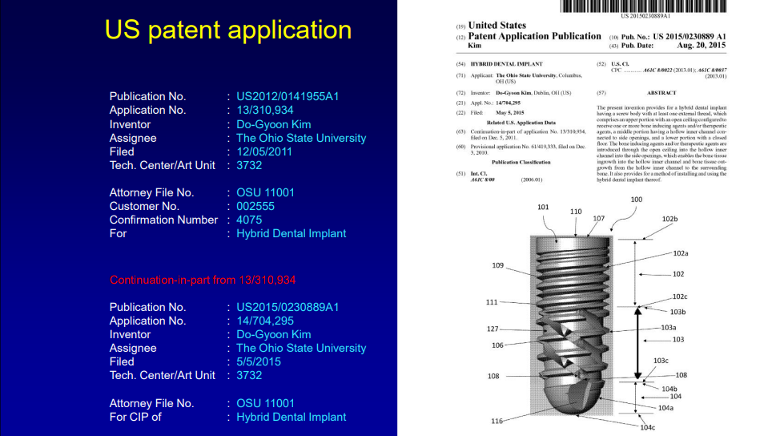
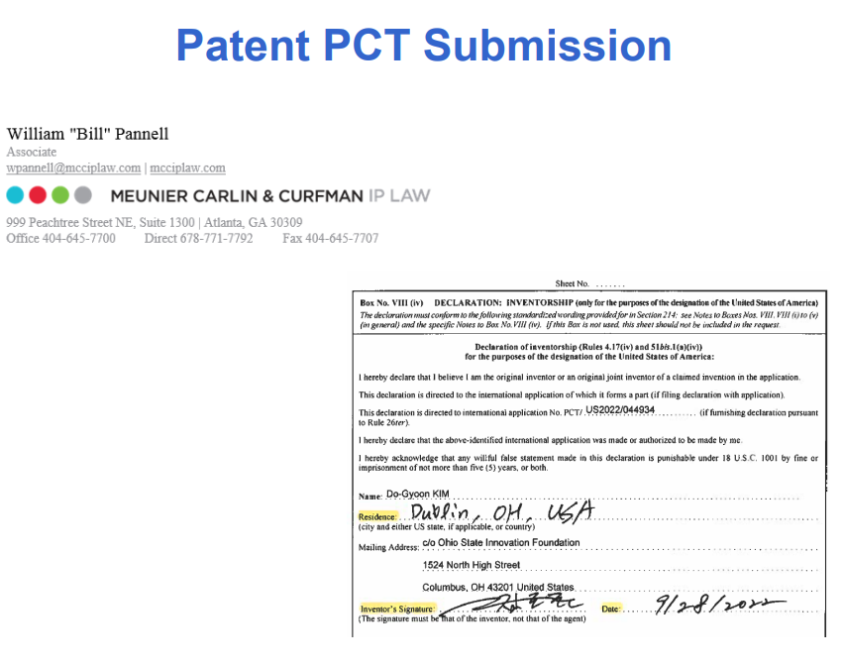
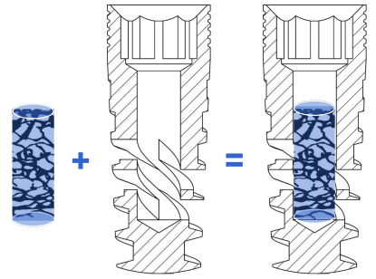

World's First Hybrid Dental Implant Technology
Revolutionary Bone Ingrowth Technology
US Patented Game-Changing Dental Implant
First-ever Injectable Implant System
*PCT for Global Patent Strategy
*PCT = Patent Cooperation Treaty: International filing system enabling patent protection across 150+ countries simultaneously
“Transforming 30 years of implant limitations into breakthrough patient solutions”
Result: 40% more bone contact, 0 months waiting time
The sleeping giant awakens - First fundamental implant breakthrough in 30+ years transforms patient access to those who need it most

Slide 5
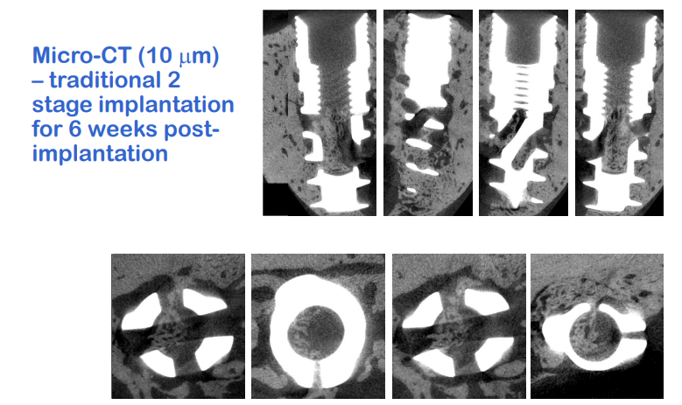
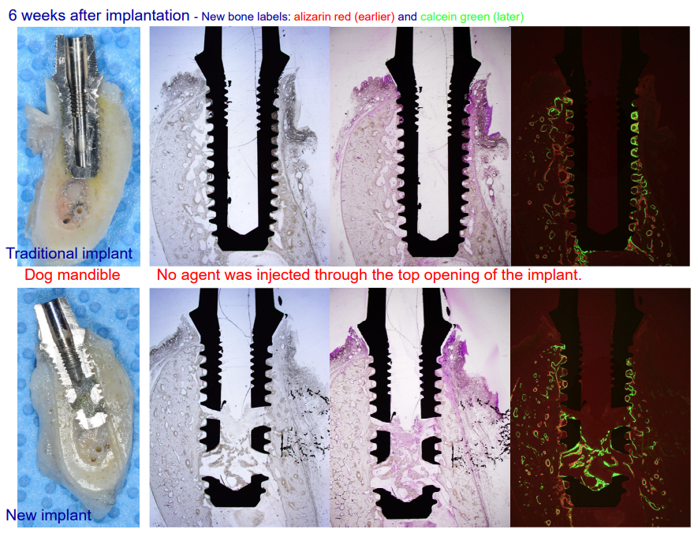
Redefining Implant Excellence: Safer, Faster, Simpler
*Publication : Journal of Mechanical Behavior of Biomedical Materials (2020)
40%
$3K
3D
100%
Improved Contact
Cost Savings
Stronger Stability
Compatibility
Better bone-to-implant contact
compared to traditional implants
Eliminates bone grafting cost
and 6-month waiting period
Enhanced structural stability through 3-dimensional bone ingrowth
Works with existing surgical
instruments and procedures

Slide 6

Key Milestones on Our Journey
2020
1
HuMed Lifesciences LLC (US entity) incorporated
Hybrid Dental Implant(US 9757213B2) licensing option agreement with OSU
2
2021
KISED Grant ($100K) TVSF II (Ohio State) Grant ($150K)
Full licensing agreement with OSU
Pre-Clinical Trial for POC Strategic Partnership (Search Med.)
2022
3
1st FDA 510K pre-submission → recommended for De Novo
Design change with Plug-in
4
2023
2nd FDA 510K pre-submission → Positive response
Testing plans formulated
2024
5
Packaging Testing: Complete
Sterility Testing: Complete
Biocompatibility Testing: Complete
6
2025
Final bench testing in progress → 510(k) submission imminent
2026
7
510(k) clearance + US launch & marketing
8
2027
Injectable De Novo path → Next-gen innovation

Slide 7
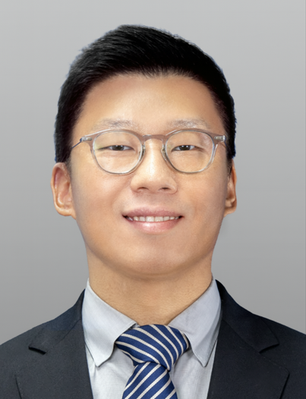
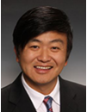

Innovation Excellence Powered by Market Mastery
Hongsuk Kim, CEO
Do-Gyoon Kim, CTO, Co-Founder
Jinyong Oh, Strategic Advisor, Co-Founder
Global commercialization expert,
ex-Samsung/J&J/P&G, Harvard A.M.
Ohio State University Professor,
Inventor of Hybrid Implant, 20+ years R&D
J&J Medical Devices & P&G veteran,
global scaling expert, MIT MBA
Advisory Board
John Y. Hong
Dr. Sreenivas Koka
DDS, Serial Entrepreneur, Georgia Tech / Northwestern alum
Dean, Univ. of Mississippi Dentistry, ex-Mayo Clinic Chair
Paul Fagan
Tomas Cole
Serial life science entrepreneur, ECM CEO, MIT MBA
VP, Dentsply Sirona & Inkbit (3D), MIT MBA

Slide 8
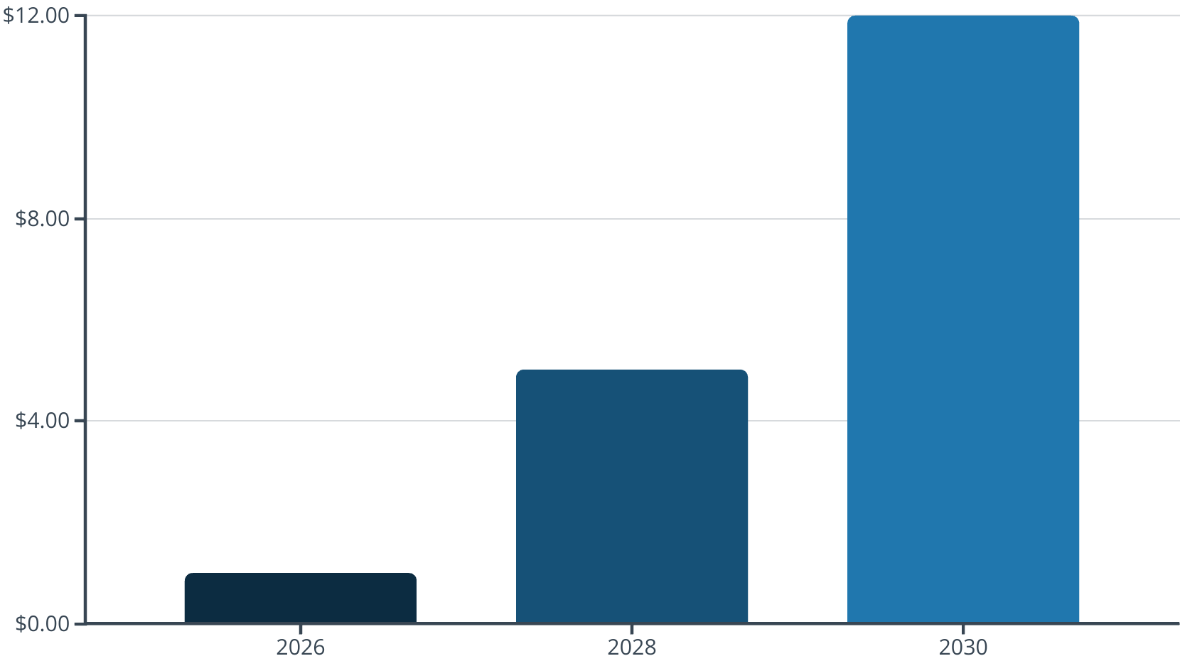



Strategic Market Expansion: Path to $10M Revenue
4-Year Path to $10M+ Revenue
Go-To-Market Strategy
$10M+
Phase 1: Frictionless Adoption
Target: General Practice Dentists (27K)
Same workflow, same cost, revolutionary results
→ Higher margins & patient satisfaction
Phase 2: Gateway Enabler
Target: Non-implant General Dentists (108K)
Simplified procedures, enhanced outcomes
→ Start implants with confidence
Phase 3: Technical Supremacy & Premium Leadership
$1M
Target: Implant Specialists (8K)
Injectable innovation conquering complexity
→ Simplified procedures & clinical excellence

Slide 9
Investment Opportunity – Transforming $4.7B Dental Market
Valuation & Terms
Strategic Fund Allocation (24 Months)
Current Valuation
R&D & Clinical (35%)
510(k) submission & validation, injectable system optimization
Regulatory & Launch (25%)
FDA approval, quality systems, manufacturing compliance for entry
Sales & Marketing (20%)
Digital platform development, KOL network, early customer acquisition
Manufacturing (15%)
Supply chain establishment & inventory build-up
Operations & Team (5%)
Working capital, key sales/marketing hires & administrative setup
1
$8M - $12M
Conservative peer analysis
Investment Opportunity
2
$1M - $2M
8-17% Equity | Q3 2025 Close
Contact: Hongsuk Kim, CEO | Email: hskim@humedlifesciences.com | Phone: +82 10 – 4053 - 1257
Notes:
Strategic Fund Allocation (24 Months)
1. R&D & Clinical Validation - 35% ($350K-700K)
Final bench testing completion
510(k) submission preparation
Clinical data strengthening
Injectable system optimization
2. Regulatory & Market Entry - 25% ($250K-500K)
FDA 510(k) submission & approval
Quality system establishment
Manufacturing compliance setup
US market launch preparation
3. Go-To-Market Execution - 20% ($200K-400K)
Online direct-sales platform development
KOL network & influencer marketing
Phase 1 customer acquisition (GP targeting)
Digital marketing & CRM systems
4. Manufacturing & Operations - 15% ($150K-300K)
Production scale-up preparation
Supply chain establishment
Inventory management systems
Quality control processes
5. Team & Working Capital - 5% ($50K-100K)
Key sales/marketing hires
Administrative operations
Legal & professional services
General working capital

